Slide 1
Building a custom DMC Pod Plugin and Integrate it as UI Extension to DMC in CAPM Project

Slide 2
How to Create a Project in CAPM

Slide 3
CAPM Project Setup:
Open SAP Business Application Studio and navigate to your project workspace.
Right-click on the desired folder and select “Open in Integrated Terminal”.
In the terminal, run the following command to create a new CAPM (Cloud Application Programming Model) project:
cds init examplepodplugin
Next, change into the newly created project directory using: cd examplepodplugin
Then, install the necessary dependencies by running: npm install
Once the setup is complete, you will see the standard CAPM project structure with the following key folders:
app/: This folder is used for your frontend application, such as a SAP Fiori or custom POD plugin UI.
db/: Contains your data model files, typically written in CDS (Core Data Services). Here, you define your entities, relationships, and types.
srv/: This is where you define and implement your services (e.g., OData or REST) that expose your data model and business logic.

Slide 4
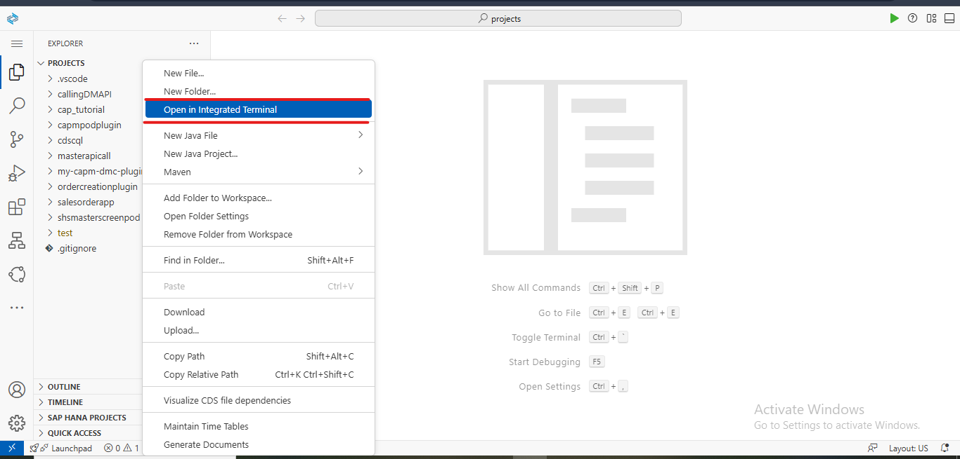

Slide 5
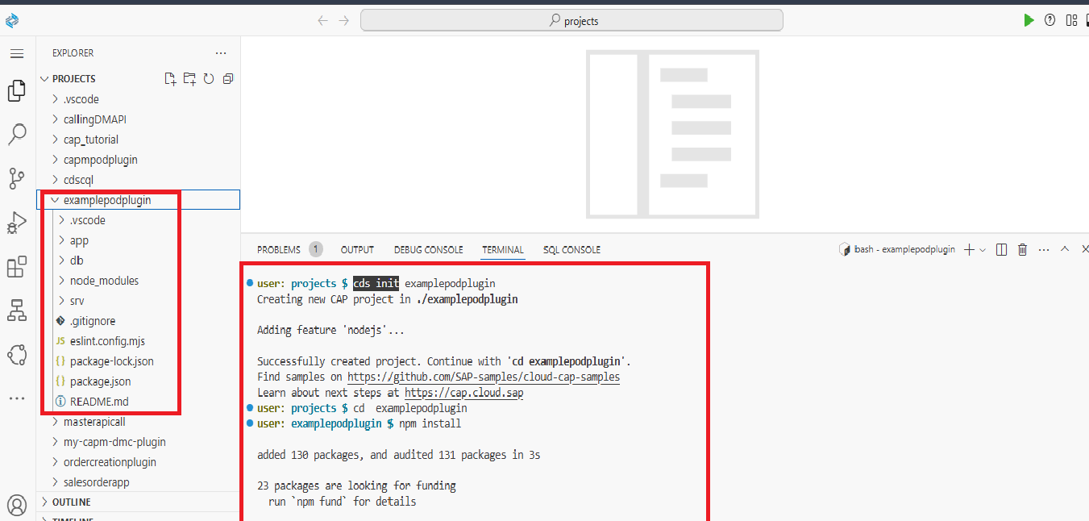

Slide 6
Defining Entities and Services in CAPM

Slide 7
Defining Entity And Service:
Right-click on the db folder, create a new file with a .cds extension (e.g., schema.cds), and add the following snippet:
namespace capmdcpodplugin.db;
entity Student{
key ID:String;
name:String;
age:Integer;
}
b. Next, right-click on the srv folder and create a file with the .cds extension (e.g., cat-service.cds). Then, add the following code:
using { capmdcpodplugin.db as db } from '../db/schema';
service MyService {
entity StudentDetails as projection on db.Student;
}

Slide 8
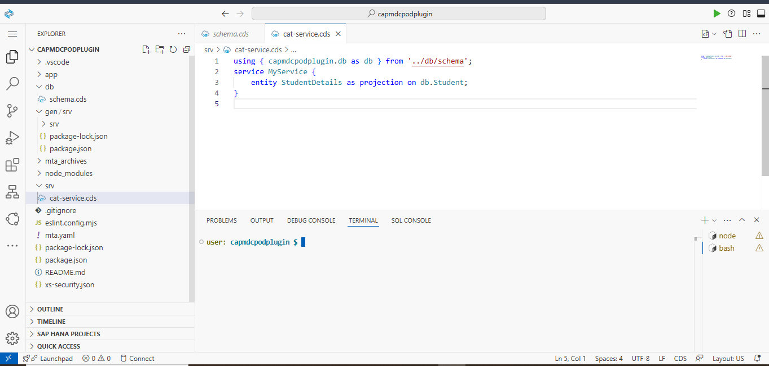

Slide 9
How to Run a CAPM Project

Slide 10
Running the CAPM Project:
Run the following command in the root directory of your project:
cds watch
After executing the command, a local server will start (usually on port 4004). You will see a URL like http://localhost: 4004 in the terminal. Hold down Ctrl and click the URL to open it in your browser.
There you can see the metadata of the service. And you can see the created services.

Slide 11
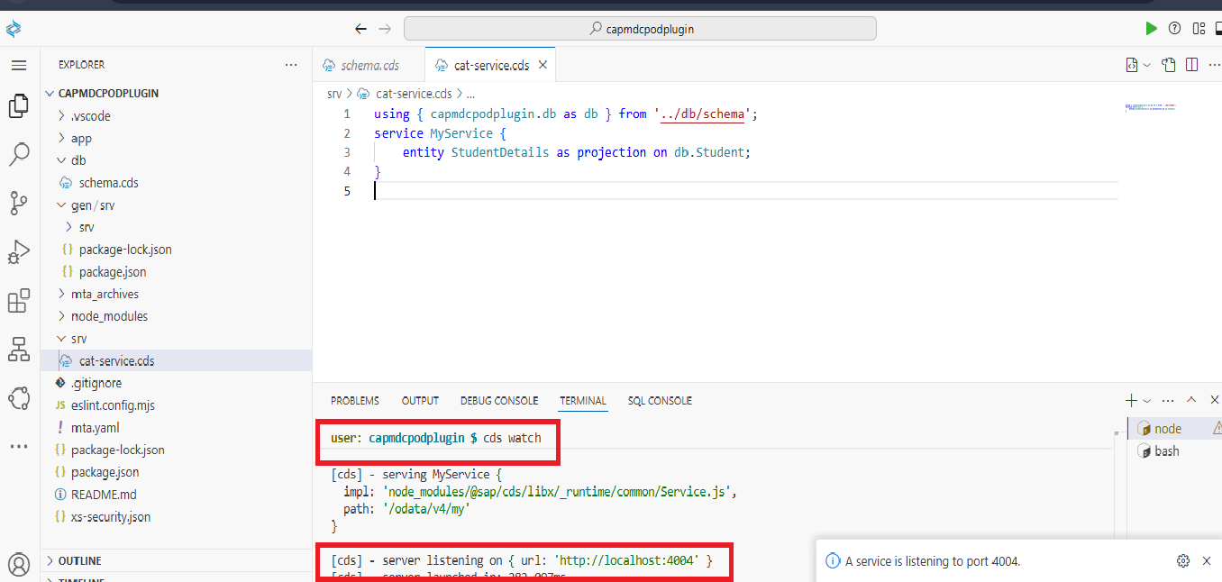

Slide 12
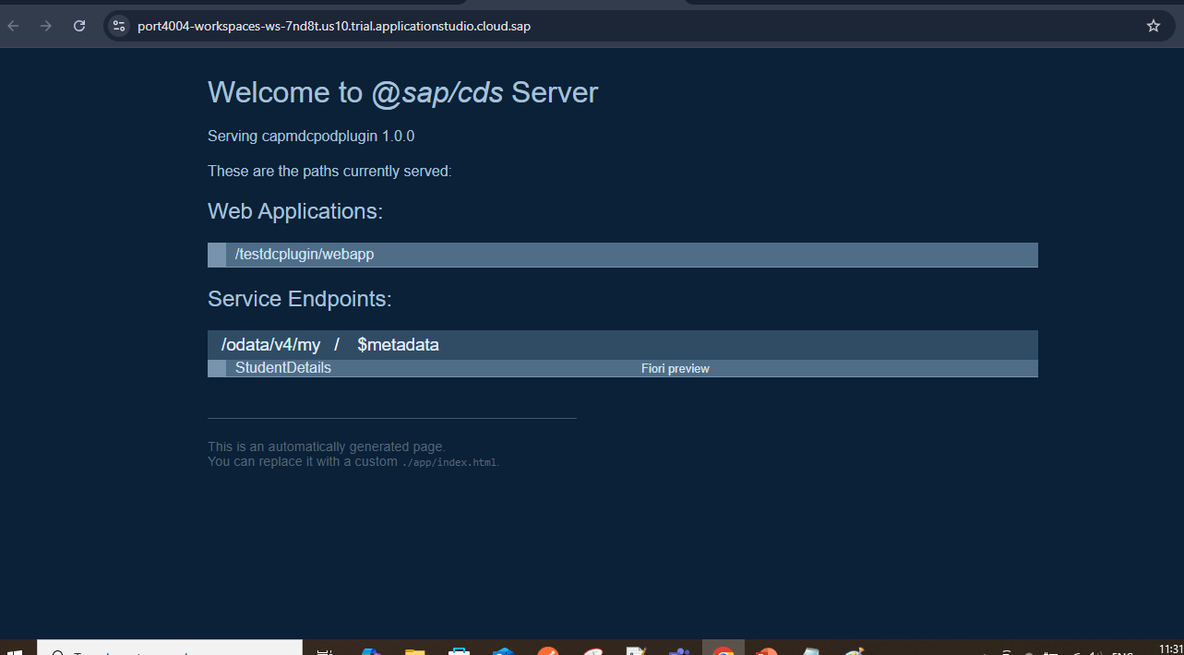
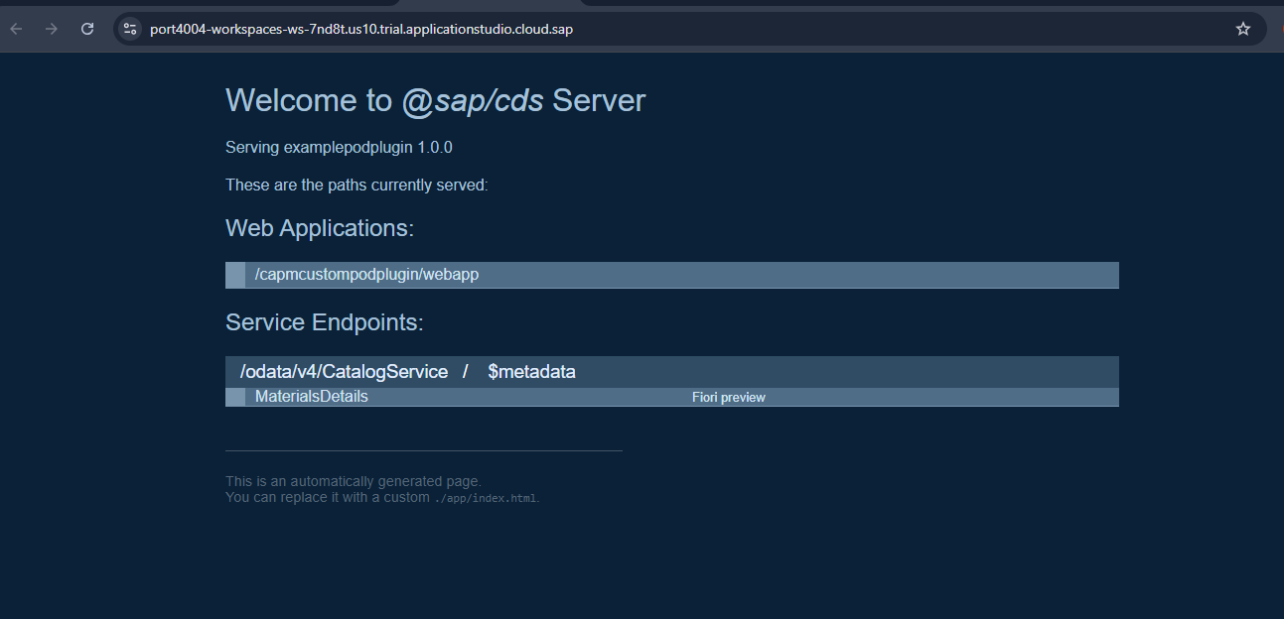

Slide 13
How to Add a Custom POD Plugin in CAPM

Slide 14
Adding Custom Plugin UI to CAPM Project:
Run the following command in the root directory of your project to install required packages for custom pod plugin.
npm install -g generator-dmcpodplugin
Next , run the below commad to create custom pod plugin:
yo dmcpodplugin
After running this command , it will ask some question and give the response like below:
? What is the name of your plugin? examplepod
? Version Number? 0.0.1
? What is your DMC host name? ritsdmc-az12fc9w.execution.eu20-quality.web.dmc.cloud.sap
? What is your plugin namespace? rits.custom.plugin
? Support WORK_CENTER PODS? Yes
? Support OPERATION PODS? Yes
? Support ORDER PODS? Yes
? Support CUSTOM PODS? Yes
? Support Line Monitor PODS? Yes
? Allow multiple instances? Yes
? Production Process Enabled? Yes

Slide 15
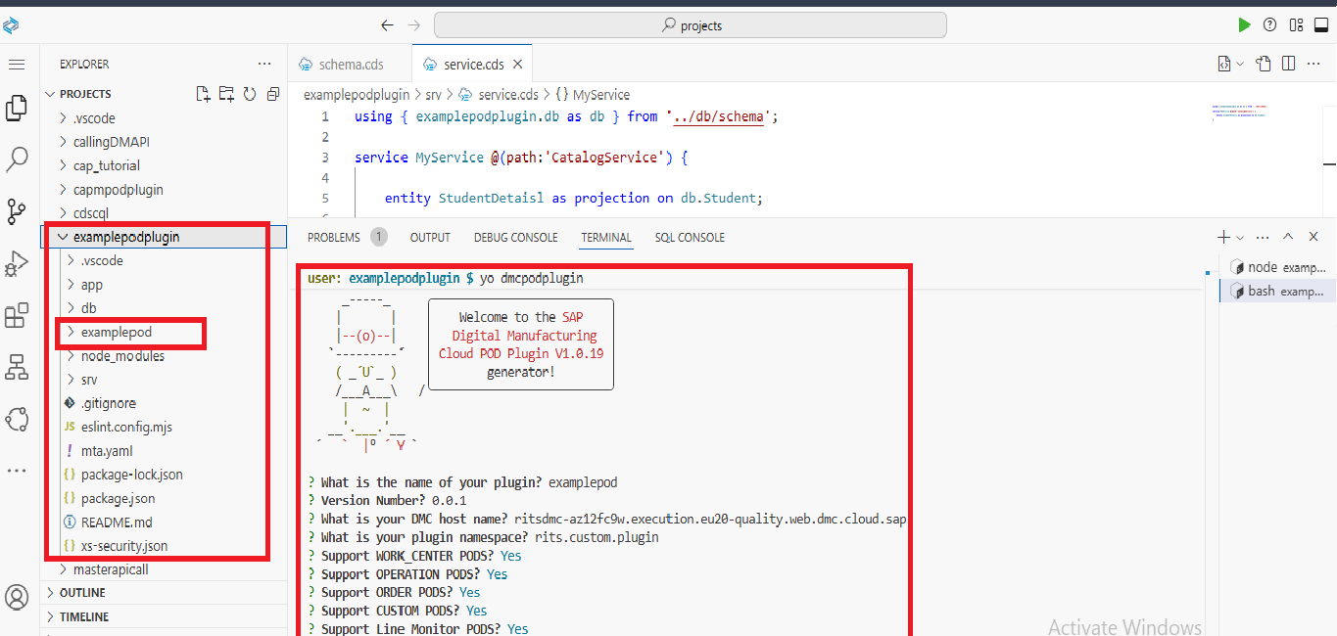

Slide 16
How to Place a Custom POD Plugin in the App Folder of a CAPM Project

Slide 17
Moving Custom POD Plugin into app folder:
Move Plugin to the App Folder:
After successfully generating your custom POD plugin (by answering all prompts),
move the generated plugin directory into the app folder of your CAPM project.
Update components.json: Important
Navigate to: app/<your-plugin-name>/webapp/designer/components.json
Then, replace or update the supportedPodTypes field like this:
"supportedPodTypes": ["WORK_CENTER", "OPERATION", "ORDER", "OTHER"]
If "OTHER" is missing, be sure to add it manually.

Slide 18
How to Build YAML File and Deploy the MTAR File in CAPM

Slide 19
Building and Deploying a CAPM Project on Cloud Foundry:
Build the MTA Project
Right-click on the mta.yaml file and select Build MTA Project. If you receive an error the “examplepod" path of the " examplepod " module does not exist, check the path under the modules section in your mta.yaml.
It should point to your UI5 app like this: app/<your-plugin-name>
Locate the MTAR File:
After a successful build, a new folder named mta_archives will be created at the root of your project.
Inside it, you’ll find a .mtar file.
Deploy the MTAR File:
Right-click on the .mtar file inside mta_archives and choose Deploy MTA Archive.
After successful deployment, a new application will be created in Cloud Foundry, named with your plugin, and it should appear in a Running status.

Slide 20
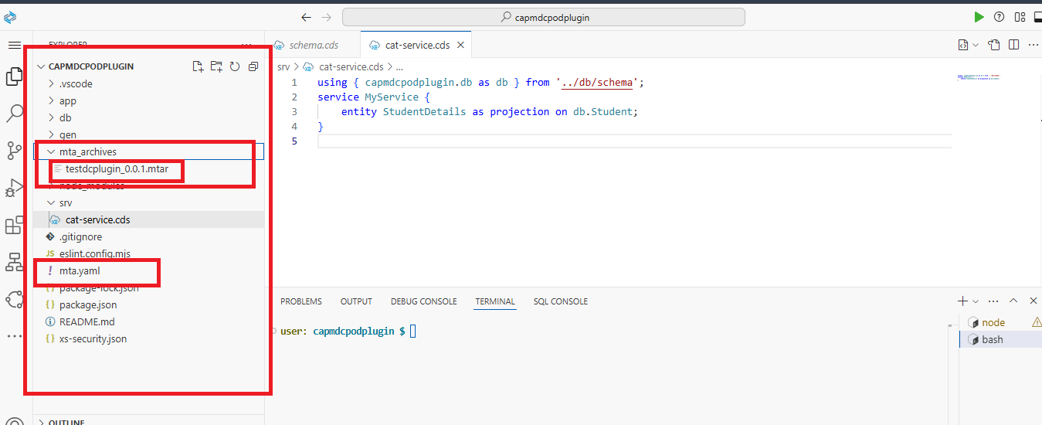

Slide 21
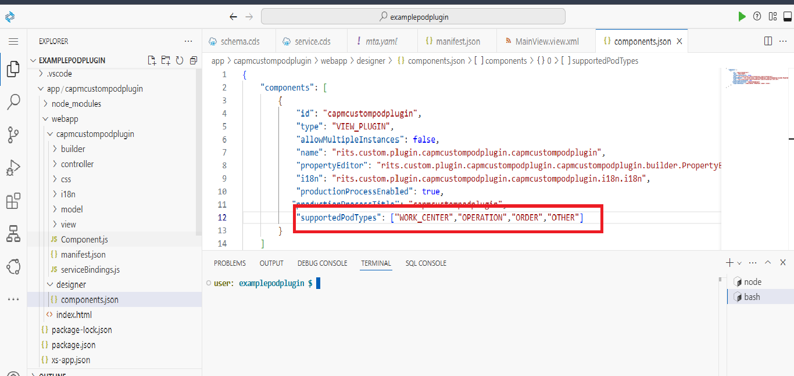
Updating components.json

Slide 22
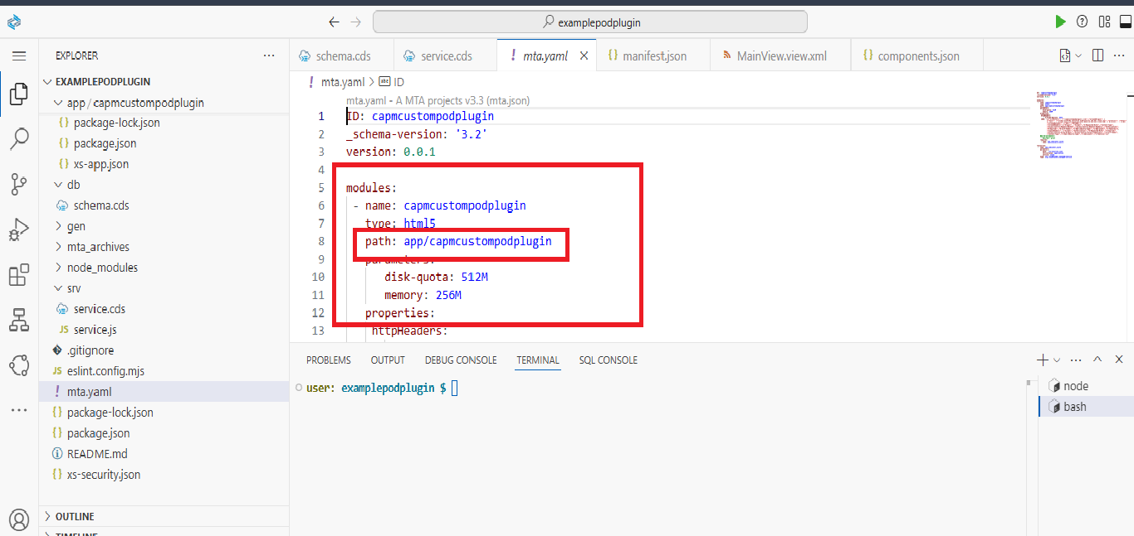
Adding path in mta.ymal file

Slide 23
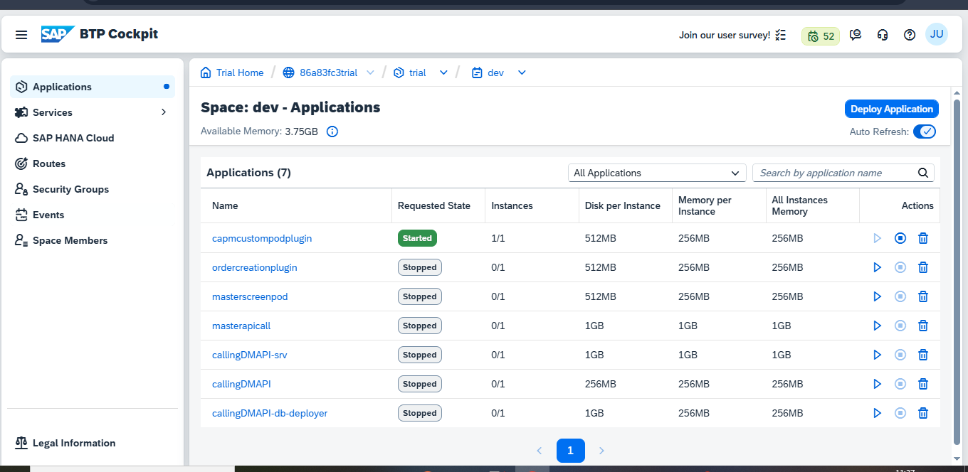
Click on the application to view the URL of your deployed plugin.

Slide 24
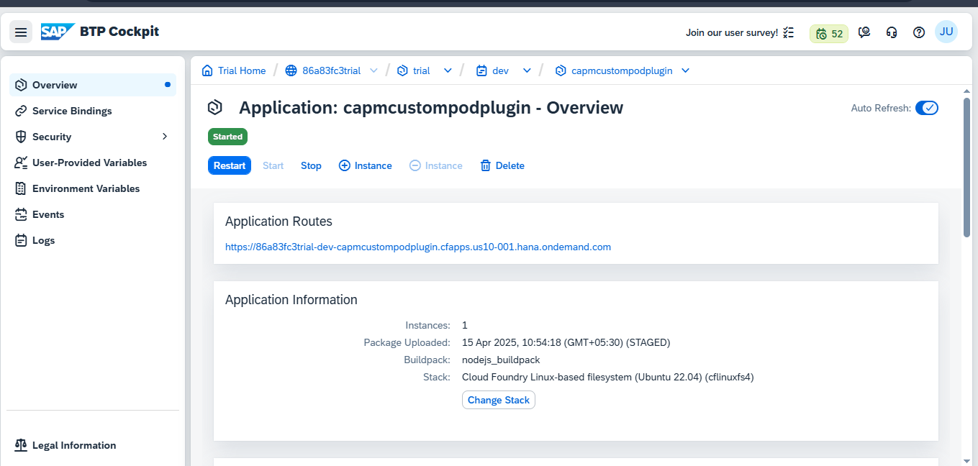
Now, copy the URL of the deployed plugin. This URL will be used for registering the plugin in the Web Server and UI Extensions section of your CAPM project in Service Registry.

Slide 25
Registering CAPM Project in Manage Web Server And Manage Service Registry UI Extension

Slide 26
Registering the Deployed Custom Plugin in the Manage Web Server

Slide 27
Manage Web Server:
Open the "Manage Web Server" app in SAP DMC and follow these steps:
Click on the Create button.
Fill in the following details:
Name: MyExamplePodPlugin
Plant: MB01
Description: Creating server for the CAPM Project
Type: Cloud Services
In the URL field, paste the URL you copied from the deployed plugin on Cloud Foundry.
Click on Create to finish the setup.

Slide 28
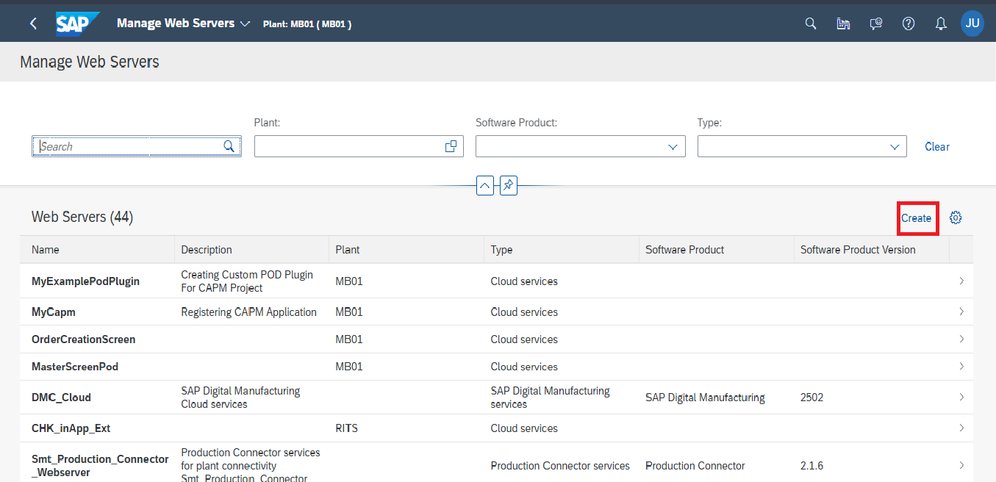

Slide 29
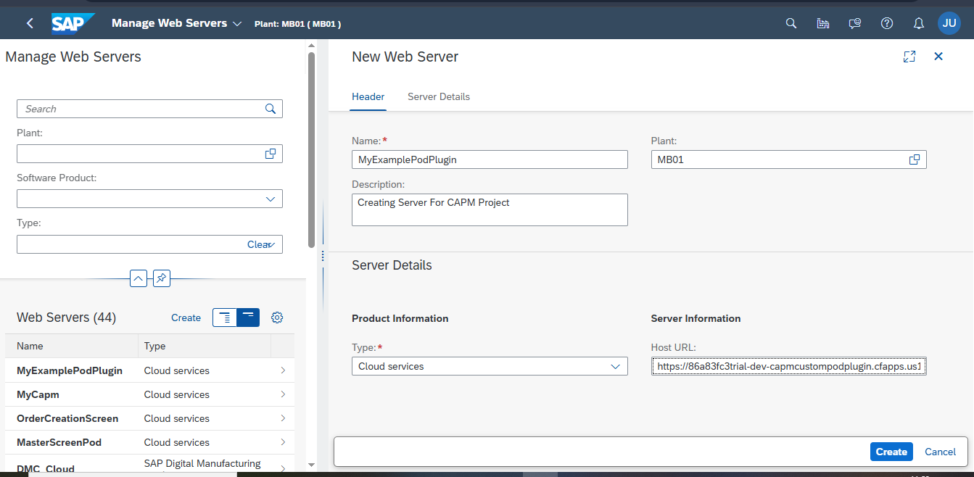

Slide 30
Consuming The Registered Web Server In The Standard DMC_Cloud Web Server

Slide 31
Consumed by DMC_Cloud Web Server
Open the Standard DMC_Cloud Web Server.
Navigate to the Connections tab.
Click the Create button.
Select the recently created web server from the list.
Then selected web server will be added to the Connections.
Now open the recently created web server for the CAPM Project.
In the Consumed tab, you will see Consumed By (1) for the newly created web server.

Slide 32
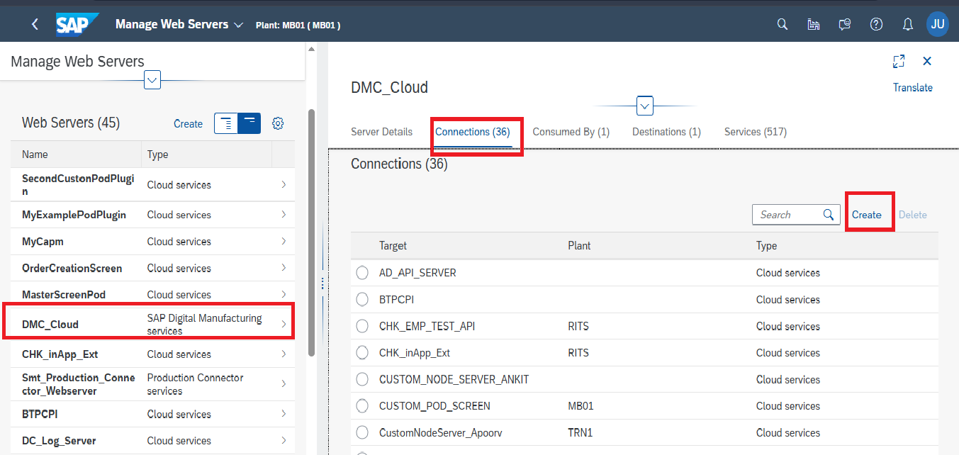

Slide 33
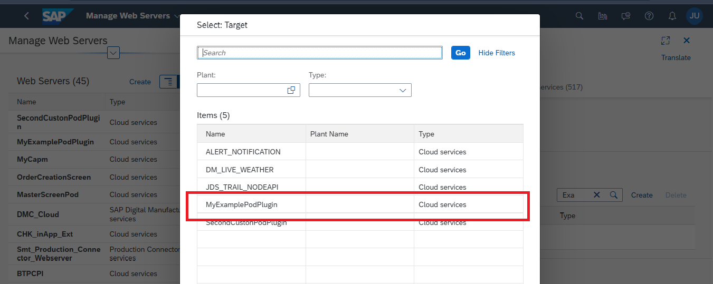

Slide 34
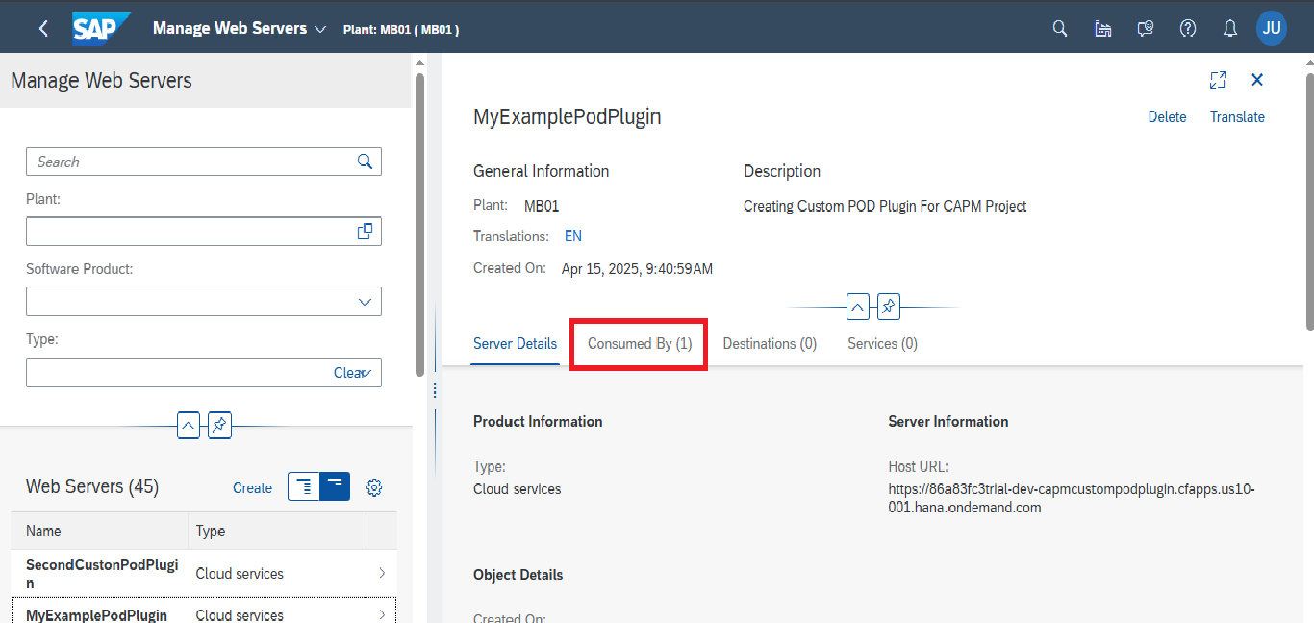

Slide 35
Registering the Deployed Custom POD Plugin with UI Extension in the Manage Service Registry

Slide 36
Manage Service Registry:
To register your plugin as a UI Extension in SAP DMC:
Open the Manage Service Registry app.
Navigate to the UI Extensions tab and click on the Create button.
Fill in the following details:
Name: MyExamplePodPlugin
Description: Creating UI Extension for CAPM Project
Type: POD Plugin
In the URL field, paste the URL copied from the deployed plugin on Cloud Foundry.
For the Path, enter the plugin path prefixed with a slash, for example: /capmcustompodplugin
For the Namespace, enter: rits/custom/plugin/capmcustompodplugin actually it is like with dots. rits.custom.plugin.capmcustompodplugin and replace with the forward slashes.
Check the checkbox of the Status filed to activate the status as enabled.
Click Create to register the UI Extension

Slide 37
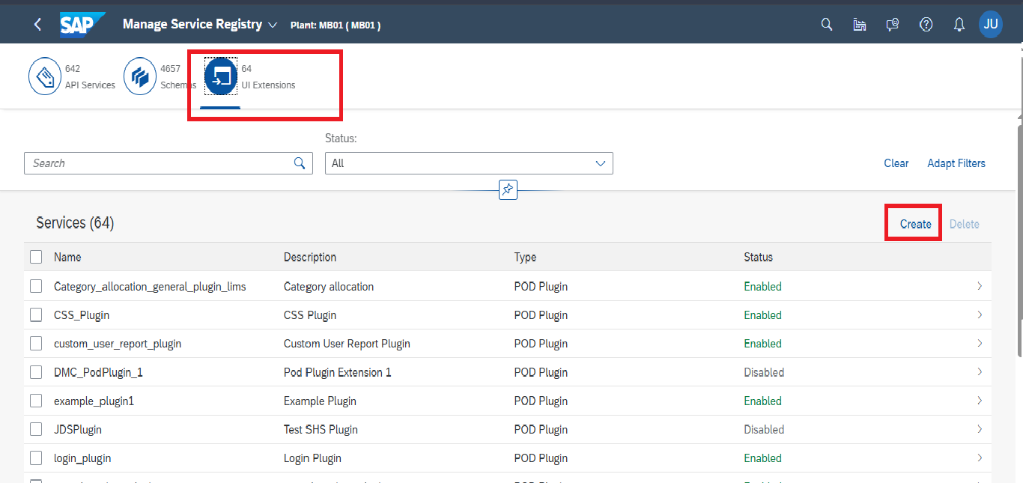

Slide 38
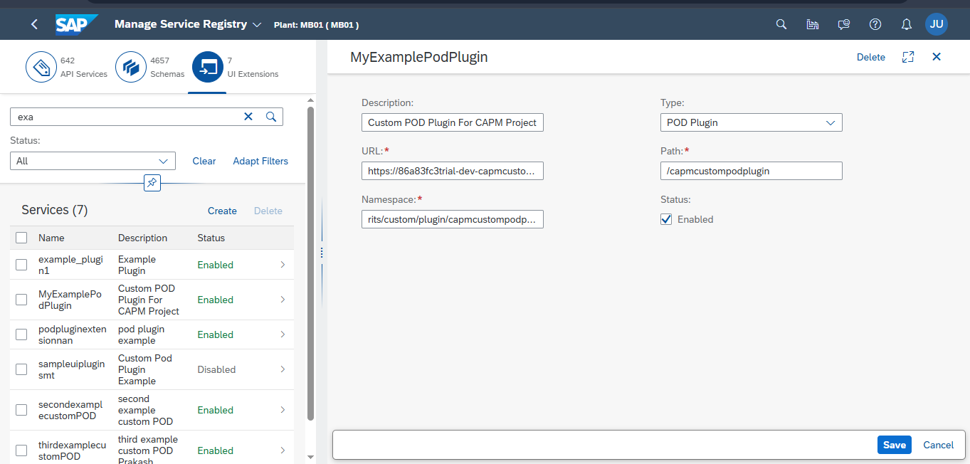

Slide 39
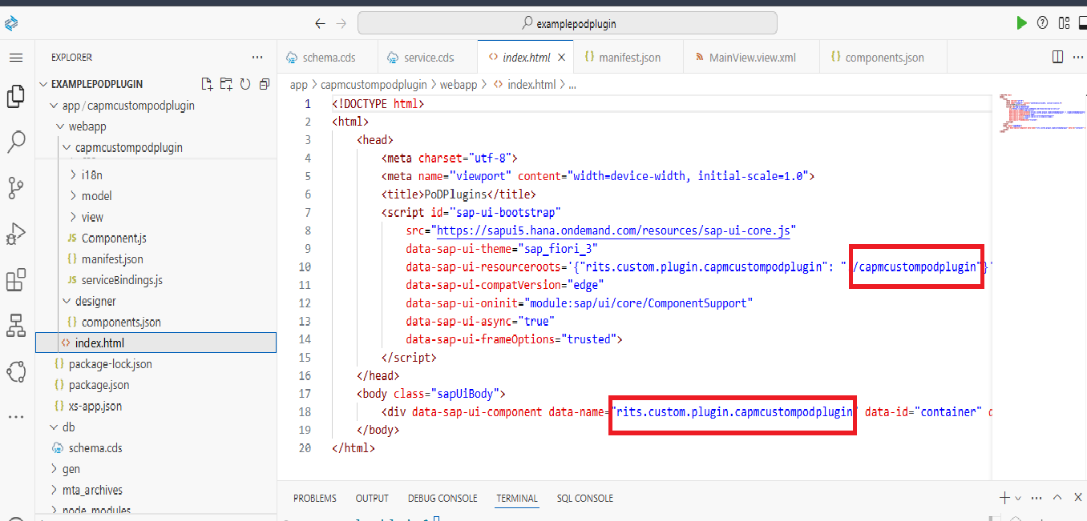
You can find the correct path and namespace inside the index.html file located in the webapp folder of your plugin project.

Slide 40
Launching the CAPM Custom POD Plugin in POD Designer

Slide 41
POD Designer:
Open the POD Designer and click Create to define a new custom POD with the following details:
Name: CAPM_CUSTOM_POD
Description: Custom POD for the CAPM Project
Type: Custom
After entering the details, click the Create button.
Once the POD is created, drag and drop a Plugin Container onto the canvas from the Layout .
In the plugin search field, locate the custom plugin you created, deployed, and registered via the Web Server and UI Extensions.
Drag and drop the identified plugin into the Plugin Container.
Check the checkbox to activate the plugin, then click the Save button.
Finally, copy the generated POD URL and open it in a new browser tab to view the plugin’s default page.

Slide 42
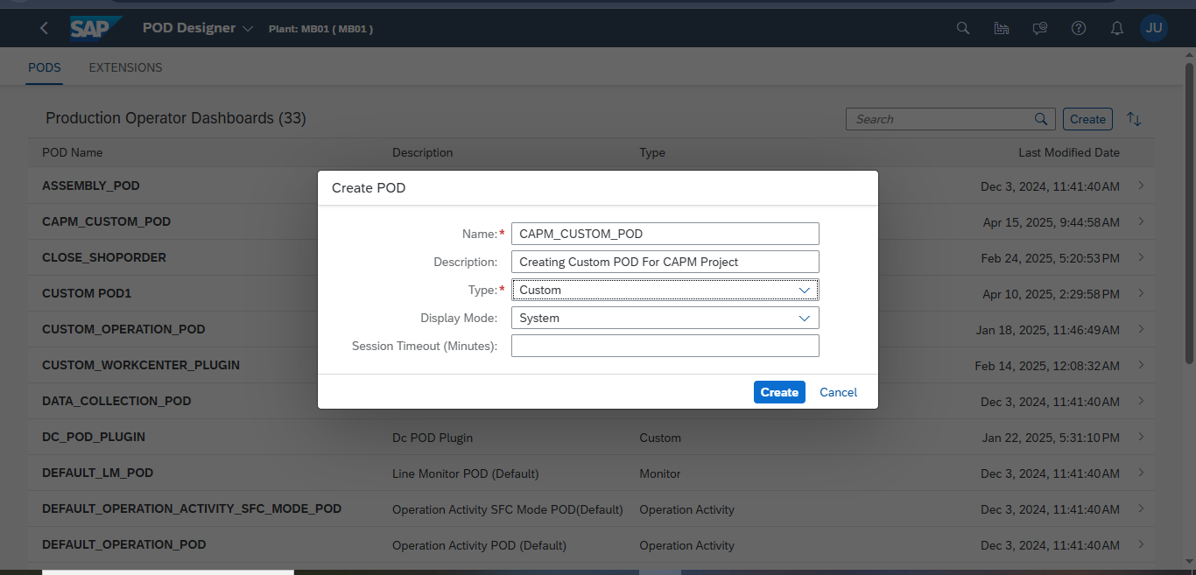

Slide 43
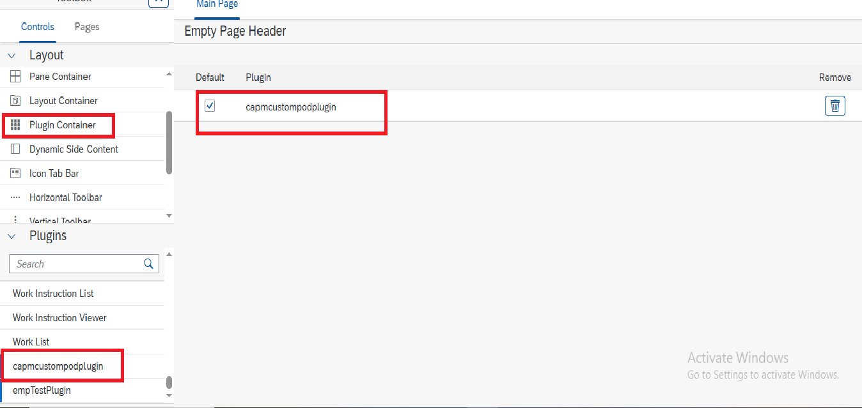

Slide 44
